Slide 1
Zinc oxide thin film Characterization.
Héctor Andrés Martínez Máynez
25/4/2019
Caracterización de Materiales

Slide 2
Index
Introduction
Sample description
Microscopies
Atomic force microscopy (AFM)
Scanning electron microscopy (SEM)
Spectroscopies
Infrared (ATR-FTIR)
Photoluminescence analysis (PL)
X-ray photoelectron spectroscopy (XPS)
X-Ray diffraction (XRD)

Slide 3
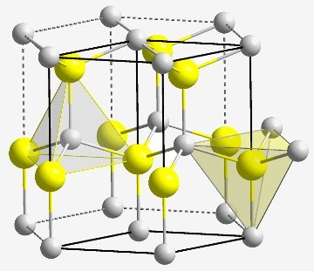


Introduction
Zinc oxide is a piezoelectric ceramic material with a promising future in the design of biosensors, it is composed of tetrahedral linked zinc and oxygen atoms. Thin films of ZnO gained special attention for de design of biosensors due to their biocompatibility, high piezoelectric response and low production cost. To take full advantage of the multiple ZnO properties is important to characterize through various techniques such as Spectroscopies and Microscopies.
Biorecognition zone
Acoustic wave emission
Interdigital transducer (IDT)
Piezoelectric transducer
Detection
Substrate
Change of frequency of Surface wave
[1]

Slide 4
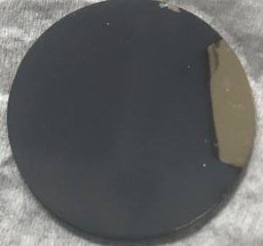
Sample Description
samples are zinc oxide thin films that were prepared via reactive magnetron sputtering using a 99.99% pure zinc target and an atmosphere of Argon and Oxygen. Samples are typically deposited over a 1 inch diameter disk of 304L stainless steel with a zinc adhesion layer.

Slide 5
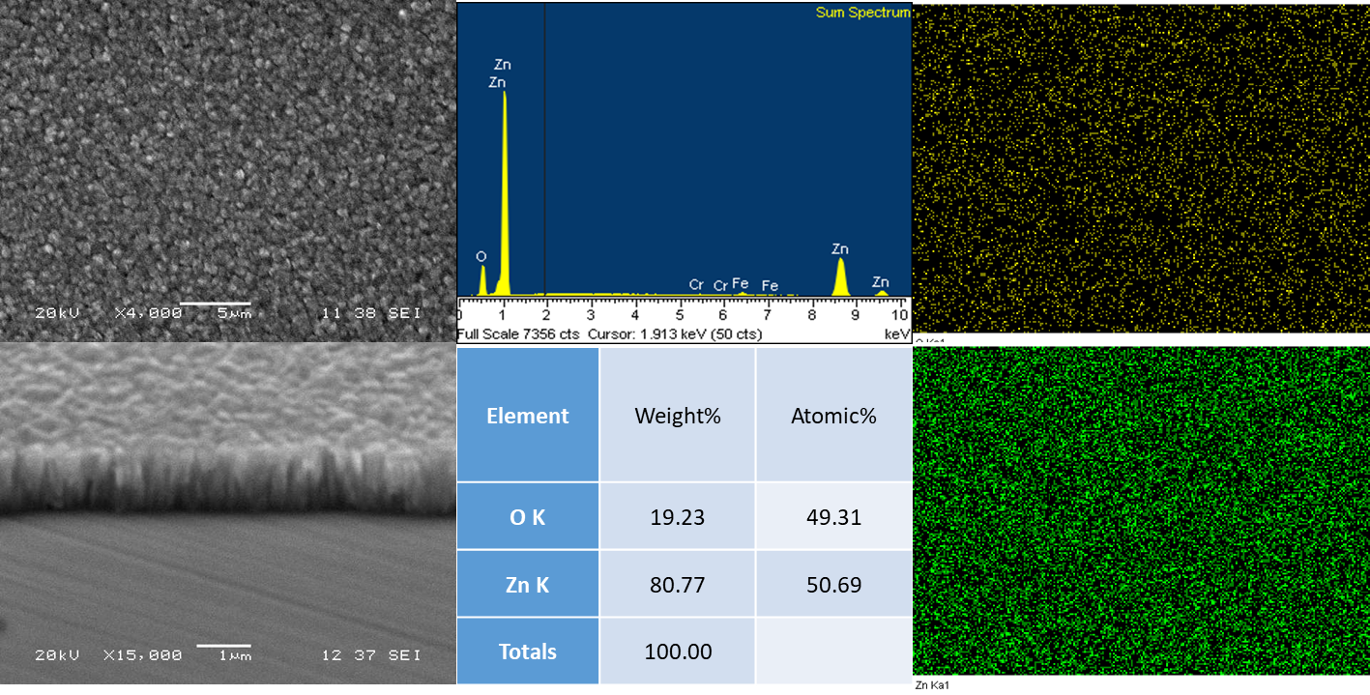
Scanning Electron Microscopy Energy dispersive X-ray spectroscopy
Through SEM surface morphology and cross section can be easily analyzed. Additional information can be obtained with an EDS analysis, Elemental composition can be quantified and mapped.

Slide 6
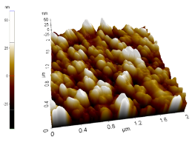
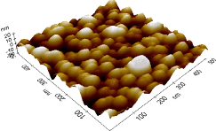
Atomic Force microscopy
Sputtered zinc oxide thin films usually possess a granular Surface as observed on SEM micrographs, the upper figure presents an undoped sputtered zinc oxide film with a granular Surface. The lower figure is an Aluminum doped ZnO film, the morphology is mostly conserved.
[2]
[3]

Slide 7
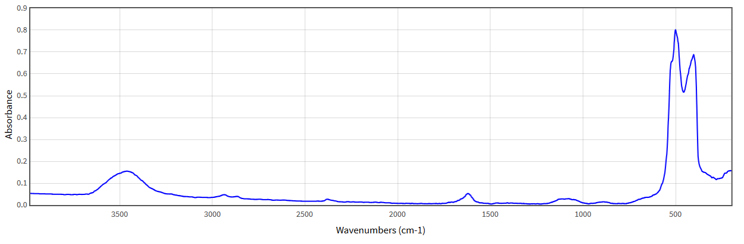
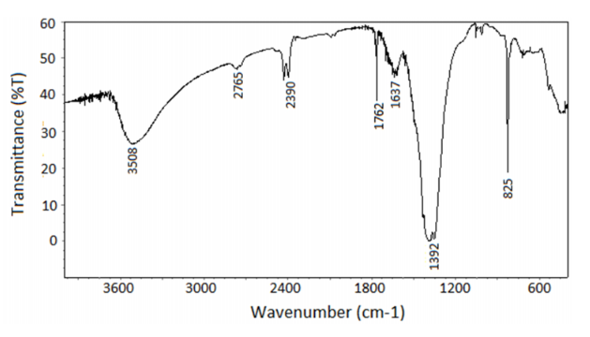
Infrared Spectroscopy
For this kind of Sample ATR-FTIR is recommended. Depending on the obtention method the infrared spectrum can change. The upper image shows a pristine ZnO sample while the lower image shows a Zinc oxide film obtained through Sol-Gel/Dip coating method.
[4]
[5]

Slide 8
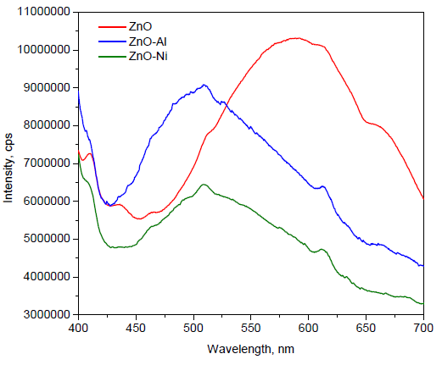
Photoluminescence Analysis
When ZnO films are irradiated with an Uv light some of the energy is reemited in the same way as fluorescence works, this property can be used on the design of optical biosensors.
[6]

Slide 9
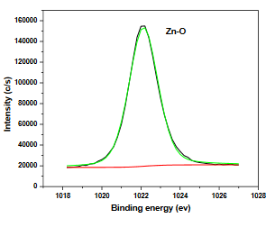
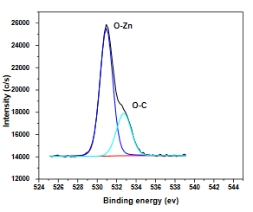
X-ray Photoelectron spectroscopy
XPS is commonly used to determine binding energies between atoms in a crystal structure. Obtained data is usually compared to bulk data to compare effects of doping and structure
[7]

Slide 10
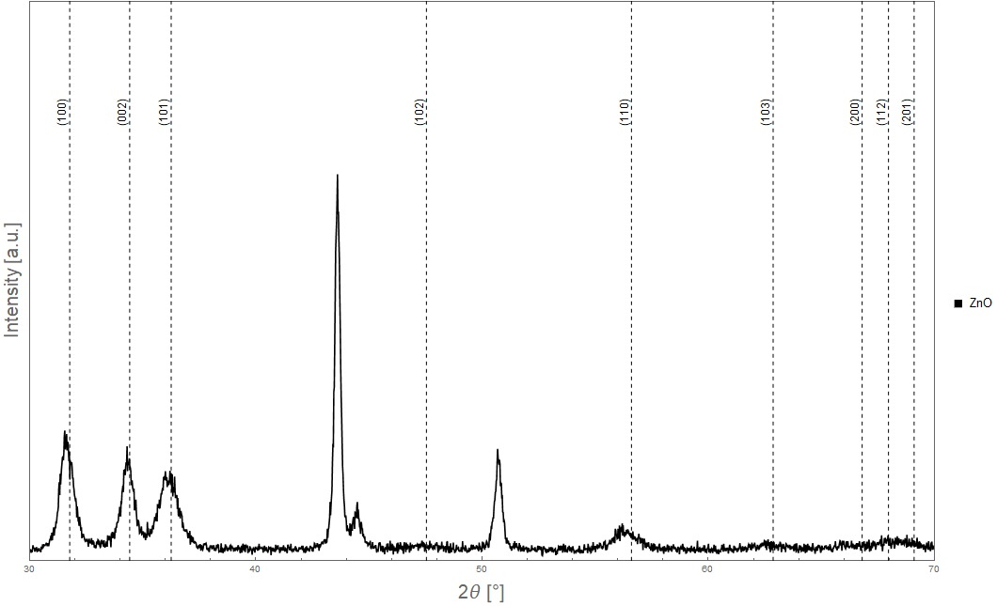
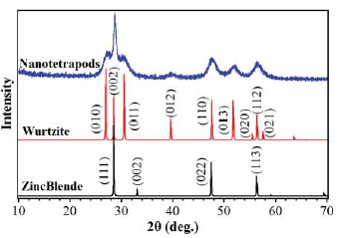
X Ray diffraction
Zinc Oxide can be obtained in two Crystal structures: hexagonal wurzite and cubic zincblende being the hexagonal configuration the most desirable.
[8]

Slide 11
References
[1] “ZnO crystal structure” recuperado de (https://whatiszincoxide.weebly.com/structure.html) el 24/4/19
[2] Kumar, B., Rao, T., (2012) “AFM studies on Surface morphology, topography and textura of nanostrucured zinc aluminum oxide thin films” Journal of nanomaterials and biostructures, vol 7 , num, 4, pages 1881-1889
[3] Siddheswaran R., Netrvalova, M.m Savkova, J. Novak, P., Ocenaek; J. Sutta, P., Kova, J., Jayavel, R. (2015) “reactive magnetrón sputtering of Ni Doped ZnO thin film: investigation of optical structural, mechanical and magnetic properties” Journal of Alloys and compound, vol 636 pag 85-92.
[4] Coblenz Society Collection(2018) “ZnO” U.S. Secreatary of Commerce
[5] Nazil, Z., Iqbal, M., Riaz, S., Zia, R., Naseem, S. (2015) “Fabrication and properties of zinc oxide thin film prepared by sol-gel dip coating method” Material science, poland, vol 33, num 3. pages 515-520
[6] Roble, A., Luna, J., Hernandez, A., Martinez, J., Rabanal, M. (2018) “Synthesis and characterization of nanocrystalline ZnO doped with Al+3 and Ni +2 by Sol-Gel method coupled with ultrasound irradiation.” Crystals, vol 8, num 406.
[7] Jilani, A. Iqbal J., Wahab, M., Jamil, Y., Al-Ghamdi, A. (2016) “X-ray Photoelectron spectroscopic (XPS) Investigation of Interface difusión of ZnO/Cu/ZNO Multilayer” Journal of Optoelectronic and biomedical materials, vol 8, num 1. pages 27-31
[8] Zhao, H., Liu, W., Zhu, J., Shen, Xi, Xiong, L., Li, Y., Li, X., Liu, J., Wang, R., Jun, C., Yu, R. (2015) “Structural transistor behavior of ZnS nanotetrapods under high pressure.” High pressure research, vol 35, No. 1 pages 9-15.

Slide 12
DRX
Zhao, H., Liu, W., Zhu, J., Shen, Xi, Xiong, L., Li, Y., Li, X., Liu, J., Wang, R., Jun, C., Yu, R. (2015) “Structural transistor behavior of ZnS nanotetrapods under high pressure.” High pressure research, vol 35, No. 1 pages 9-15.
PL
Roble, A., Luna, J., Hernandez, A., Martinez, J., Rabanal, M. (2018) “Synthesis and characterization of nanocrystalline ZnO doped with Al+3 and Ni +2 by Sol-Gel method coupled with ultrasound irradiation.” Crystals, vol 8, num 406.
IR
Nazil, Z., Iqbal, M., Riaz, S., Zia, R., Naseem, S. (2015) “Fabrication and properties of zinc oxide thin film prepared by sol-gel dip coating method” Material science, poland, vol 33, num 3. pages 515-520
Coblenz Society Collection(2018) “ZnO” U.S. Secreatary of Commerce
XPS
Jilani, A. Iqbal J., Wahab, M., Jamil, Y., Al-Ghamdi, A. (2016) “X-ray Photoelectron spectroscopic (XPS) Investigation of Interface difusión of ZnO/Cu/ZNO Multilayer” Journal of Optoelectronic and biomedical materials, vol 8, num 1. pages 27-31
AFM
Siddheswaran R., Netrvalova, M.m Savkova, J. Novak, P., Ocenaek; J. Sutta, P., Kova, J., Jayavel, R. (2015) “reactive magnetrón sputtering of Ni Doped ZnO thin film: investigation of optical structural, mechanical and magnetic properties” Journal of Alloys and compound, vol 636 pag 85-92.
Kumar, B., Rao, T., (2012) “AFM studies on Surface morphology, topography and textura of nanostrucured zinc aluminum oxide thin films” Journal of nanomaterials and biostructures, vol 7 , num, 4, pages 1881-1889

